Slide 1

Case Study: Understanding
Customer Churn
BY ONIYIDE BENJAMIN

Slide 2





Introduction to Customer Churn
What is Churn?
Churn occurs when customers stop doing business with a company. It is the "leak" in your business bucket.
Why it Matters
Acquiring new customers is 5-25x more expensive than retaining existing ones. High churn kills growth.
RETAINING CUSTOMERS = SUSTAINABLE GROWTH
The Dataset
We analyzed 7,043 customer records with 21 attributes to find patterns in why people leave.

Slide 3
The Data Science Journey
01
02
03
04
Data Cleaning
Exploration
Engineering
Modeling
Fixing missing values, correcting data types, and preparing the foundation for analysis.
Visualizing distributions, spotting outliers, and understanding the "shape" of our data.
Creating new features and encoding categories so the computer can understand them.
Training a Logistic Regression model to predict which customers are likely to leave.

Slide 4
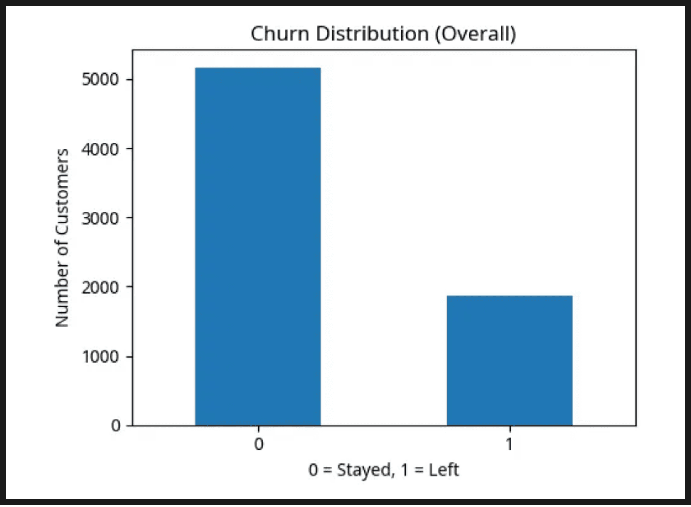
The Big Picture: Overall Churn
26.5%
Total Churn Rate
Our analysis reveals that approximately one-quarter of the customer base has churned. This "baseline" is the starting point for our investigation.
Figure 1: Distribution of Stayers (0) vs. Churners (1)

Slide 5

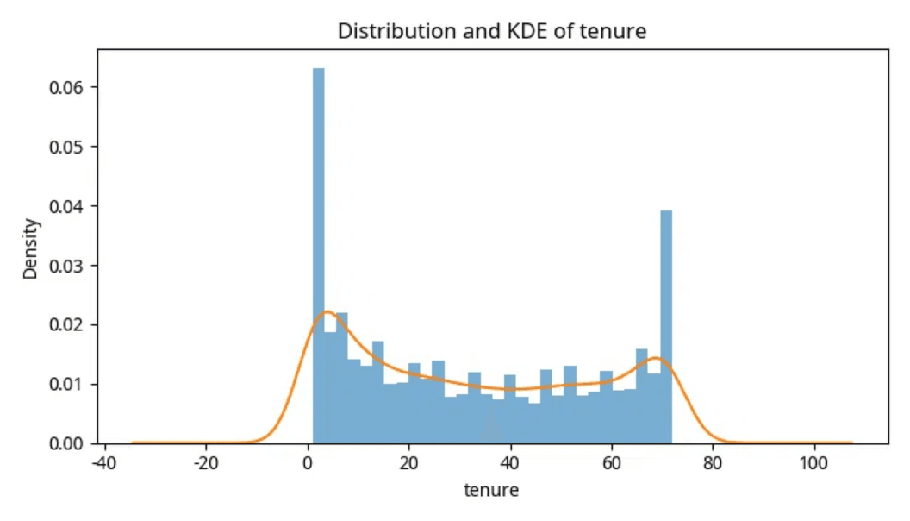
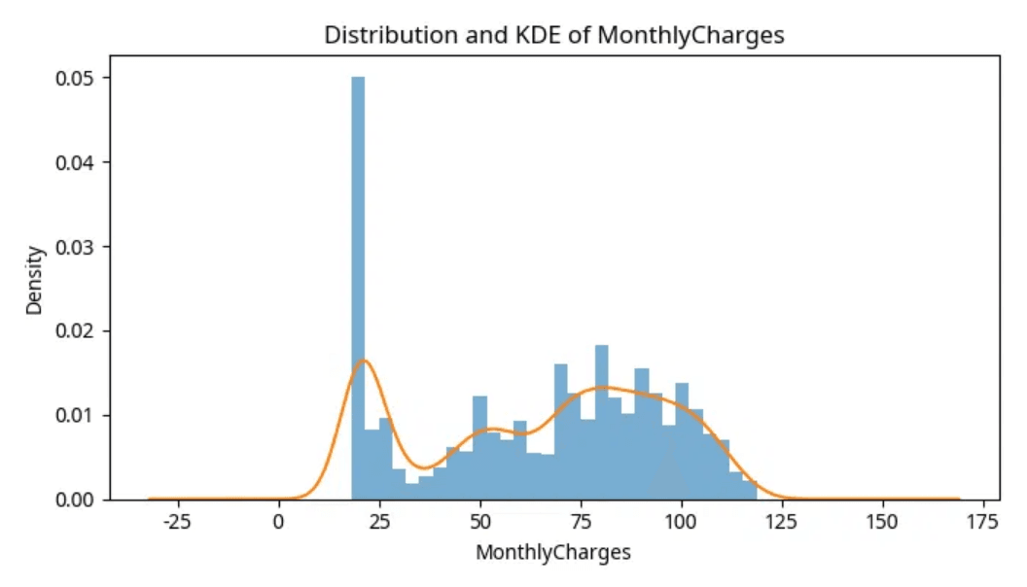
Tenure and Monthly Charges
Tenure Impact
Tenure represents how long a customer has stayed. We see a high concentration of new customers, who are often at the highest risk of leaving early.
Distribution of Customer Tenure & Monthly Charges
Monthly Billing
Monthly charges show a wide spread. Higher bills are frequently associated with higher churn rates as customers seek more affordable alternatives.
Teaching Point
Understanding the distribution of these variables helps us identify which customer segments to target for retention campaigns.

Slide 6
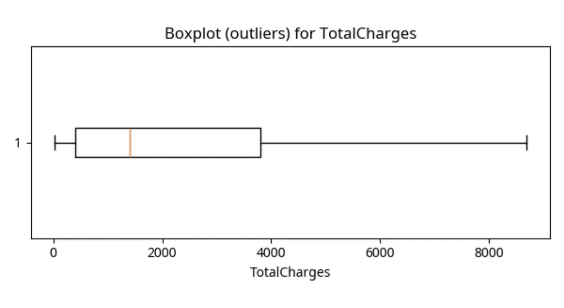
Spotting Outliers
What are Outliers?
Outliers are data points that are significantly different from the rest. They are the "rebels" in our dataset.
Why they Matter
Outliers can skew results or represent special cases like high-value customers or errors that need investigation.
The Boxplot Method
Visualizing Spread: Total Charges Boxplot
Boxplots visualize spread; points beyond the "whiskers" are flagged as potential outliers for review.

Slide 7

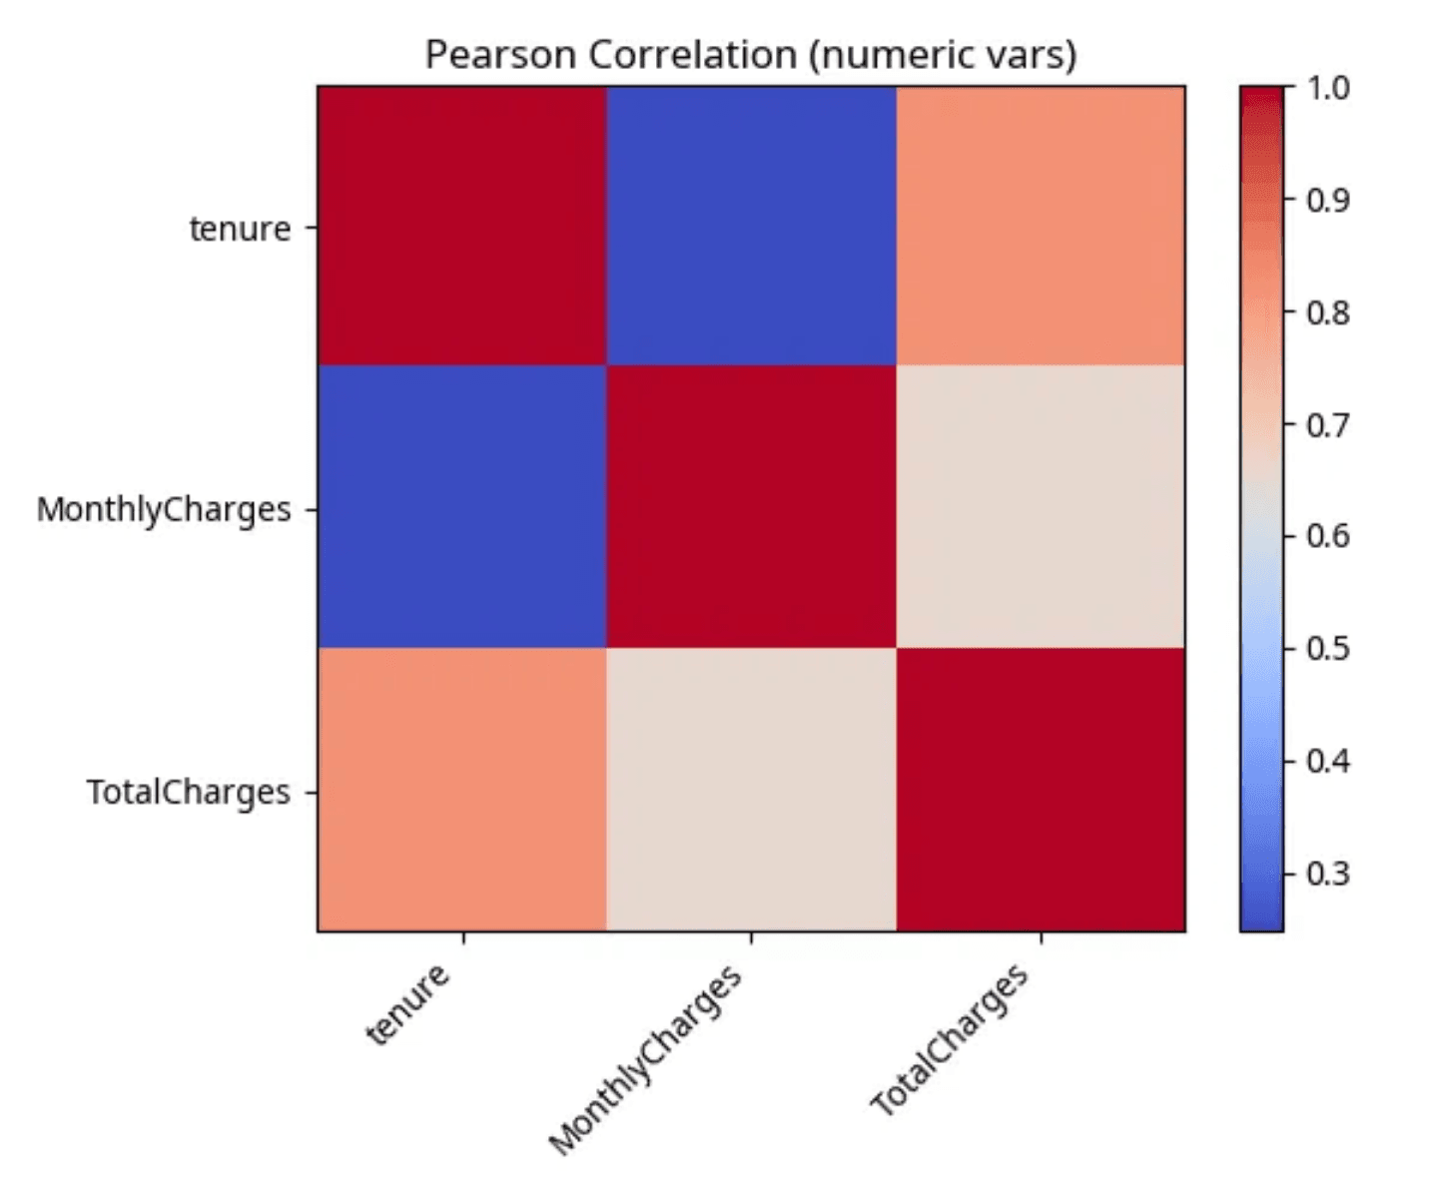
How Features Relate: Correlation
Key Relationship
Tenure and Total Charges show a clear positive correlation: longer-tenure customers pay more overall.
Multicollinearity
Highly related features can confuse models, so we watch for redundant signals.
Teaching Point
Correlation is not causation — co-movement doesn't prove cause.

Slide 8
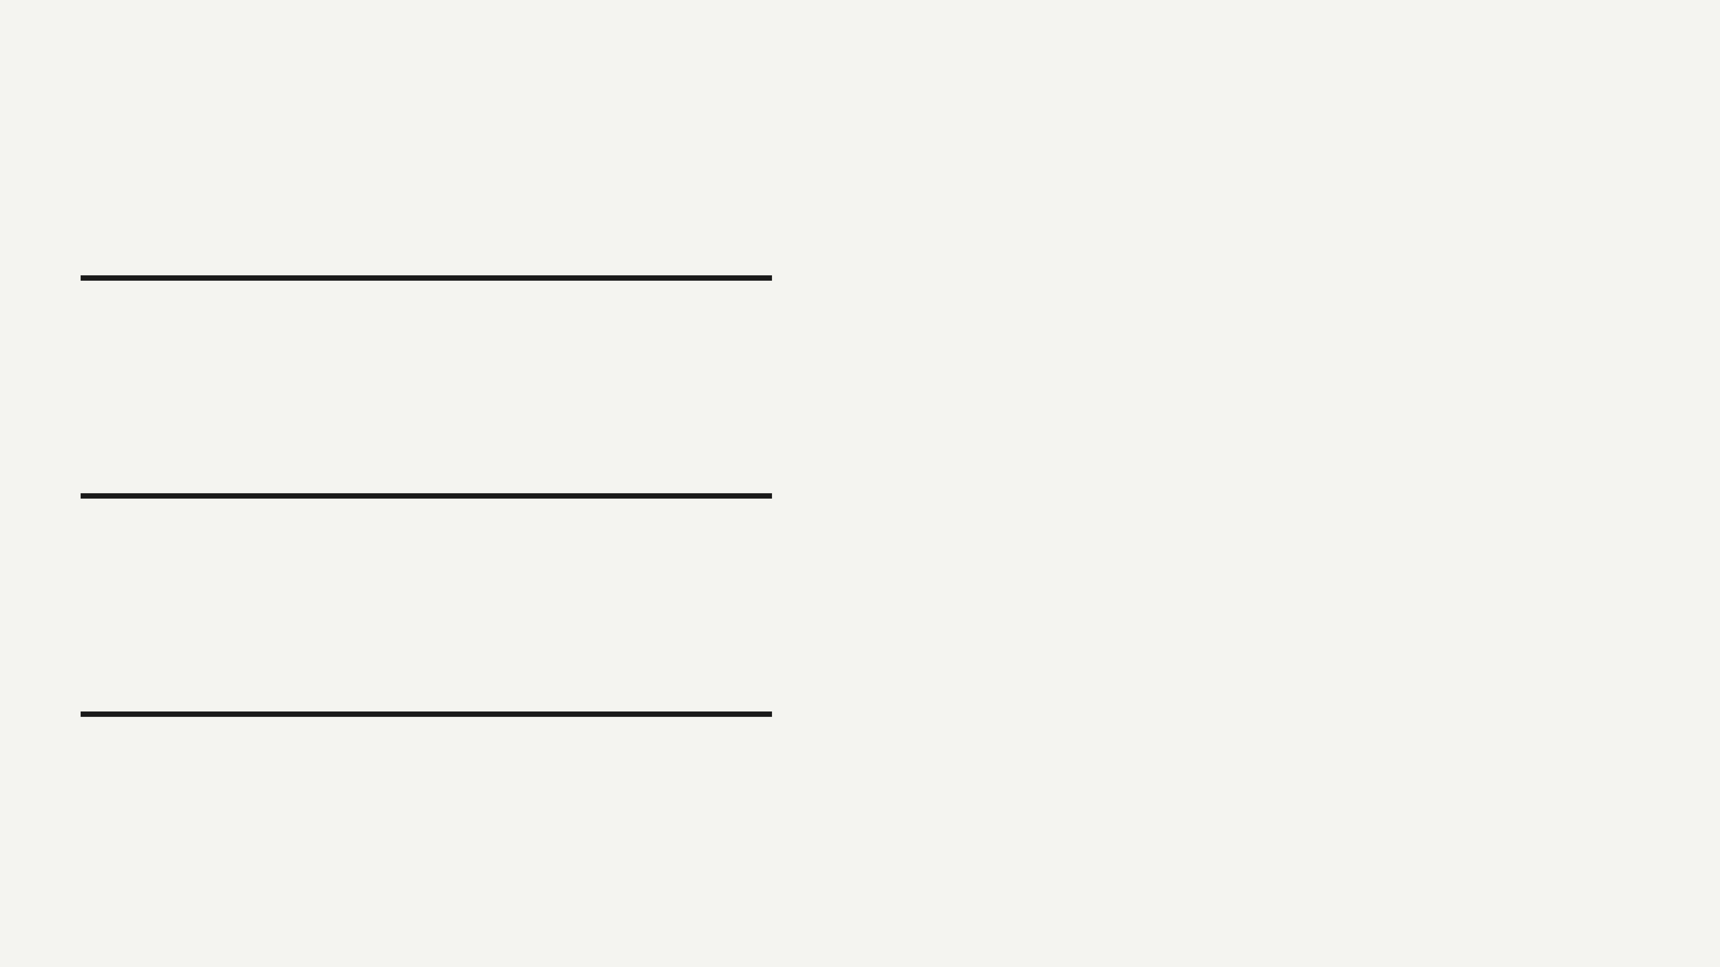
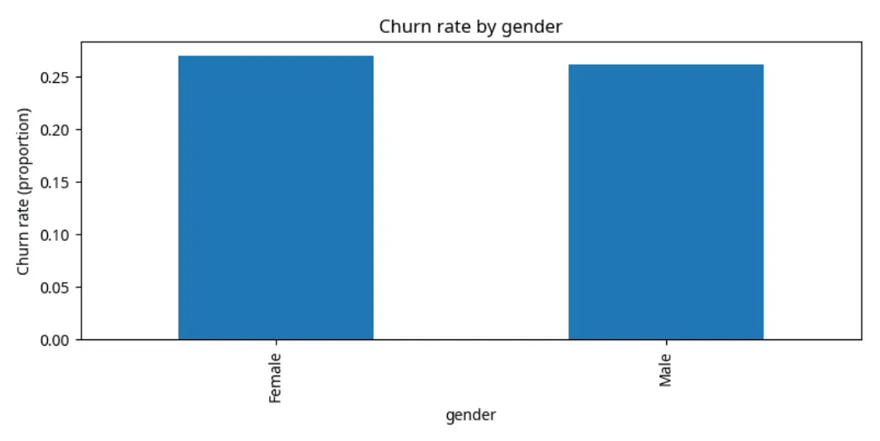
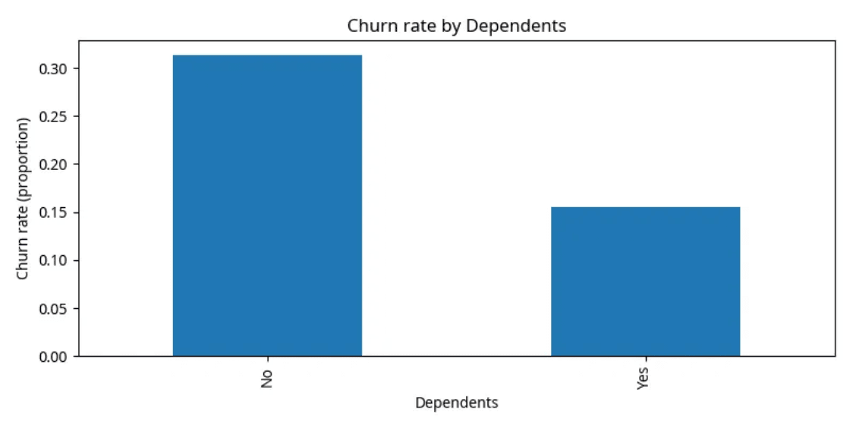
Categorical Insights
Gender Neutrality
Churn rates are remarkably similar between men and women. Gender is not a primary driver of customer loss in this dataset.
Churn Rate by Gender
Dependents & Stability
Customers without dependents show significantly higher churn rates. Those with families tend to be more stable and loyal.
Teaching Point
Churn Rate by Dependents
Demographic segmentation helps us understand "who" is leaving, allowing for more personalized marketing and retention strategies.

Slide 9
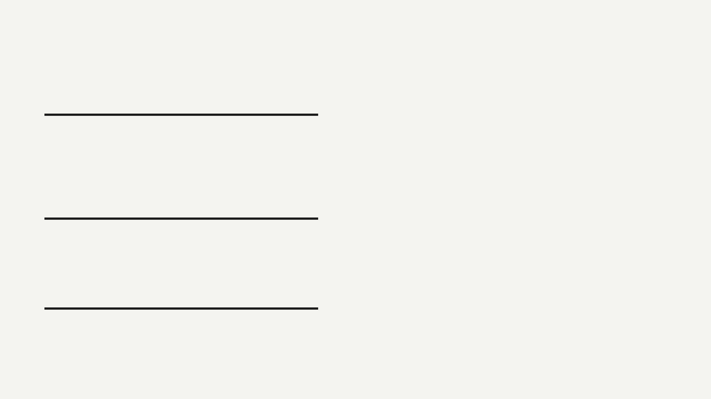
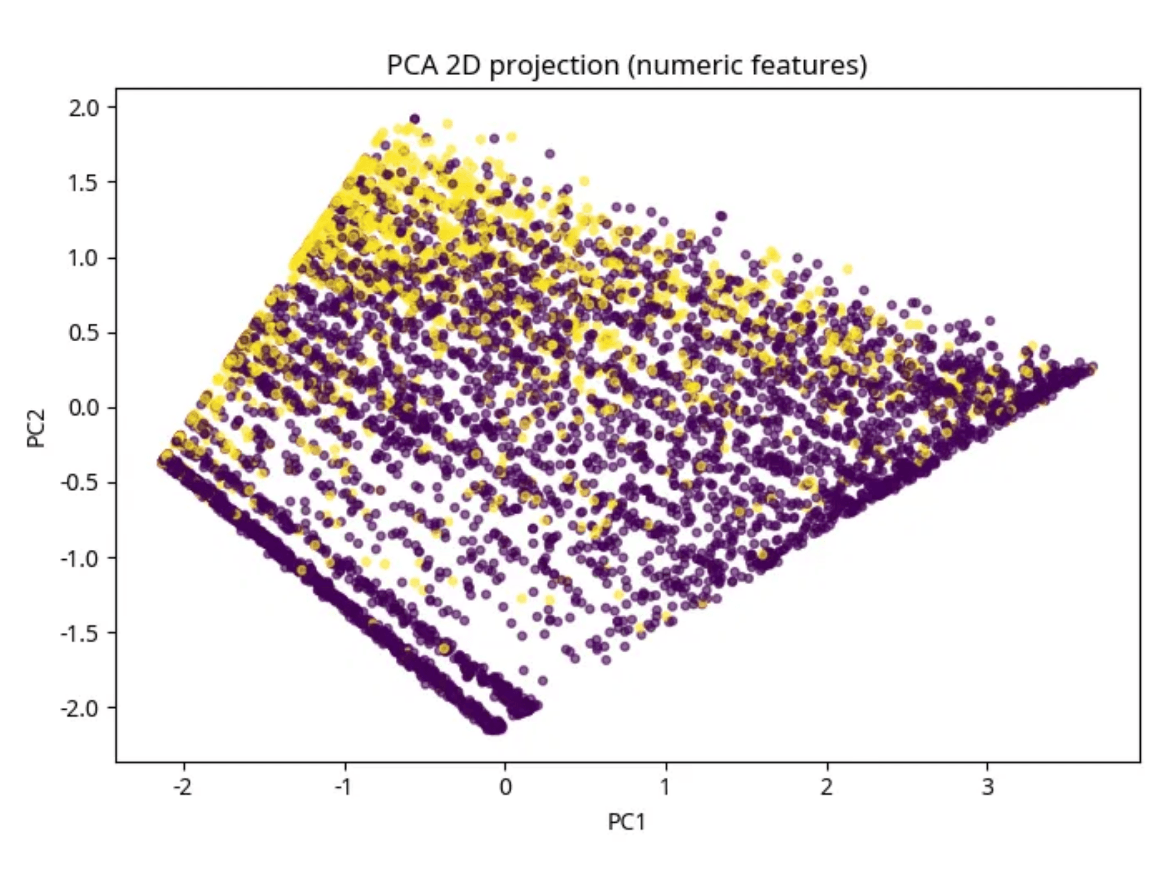
Advanced Visualization: PCA
What is PCA?
Principal Component Analysis (PCA) is a technique that "squashes" many variables into just two or three main components while keeping as much information as possible.
Finding Patterns
By projecting our data into 2D, we can see if "Churners" and "Stayers" naturally separate into different groups or clusters.
Teaching Point
Even when data is complex and high-dimensional, we can use mathematical tools to visualize it and find hidden structures.
PCA 2D Projection of Numeric Features

Slide 10
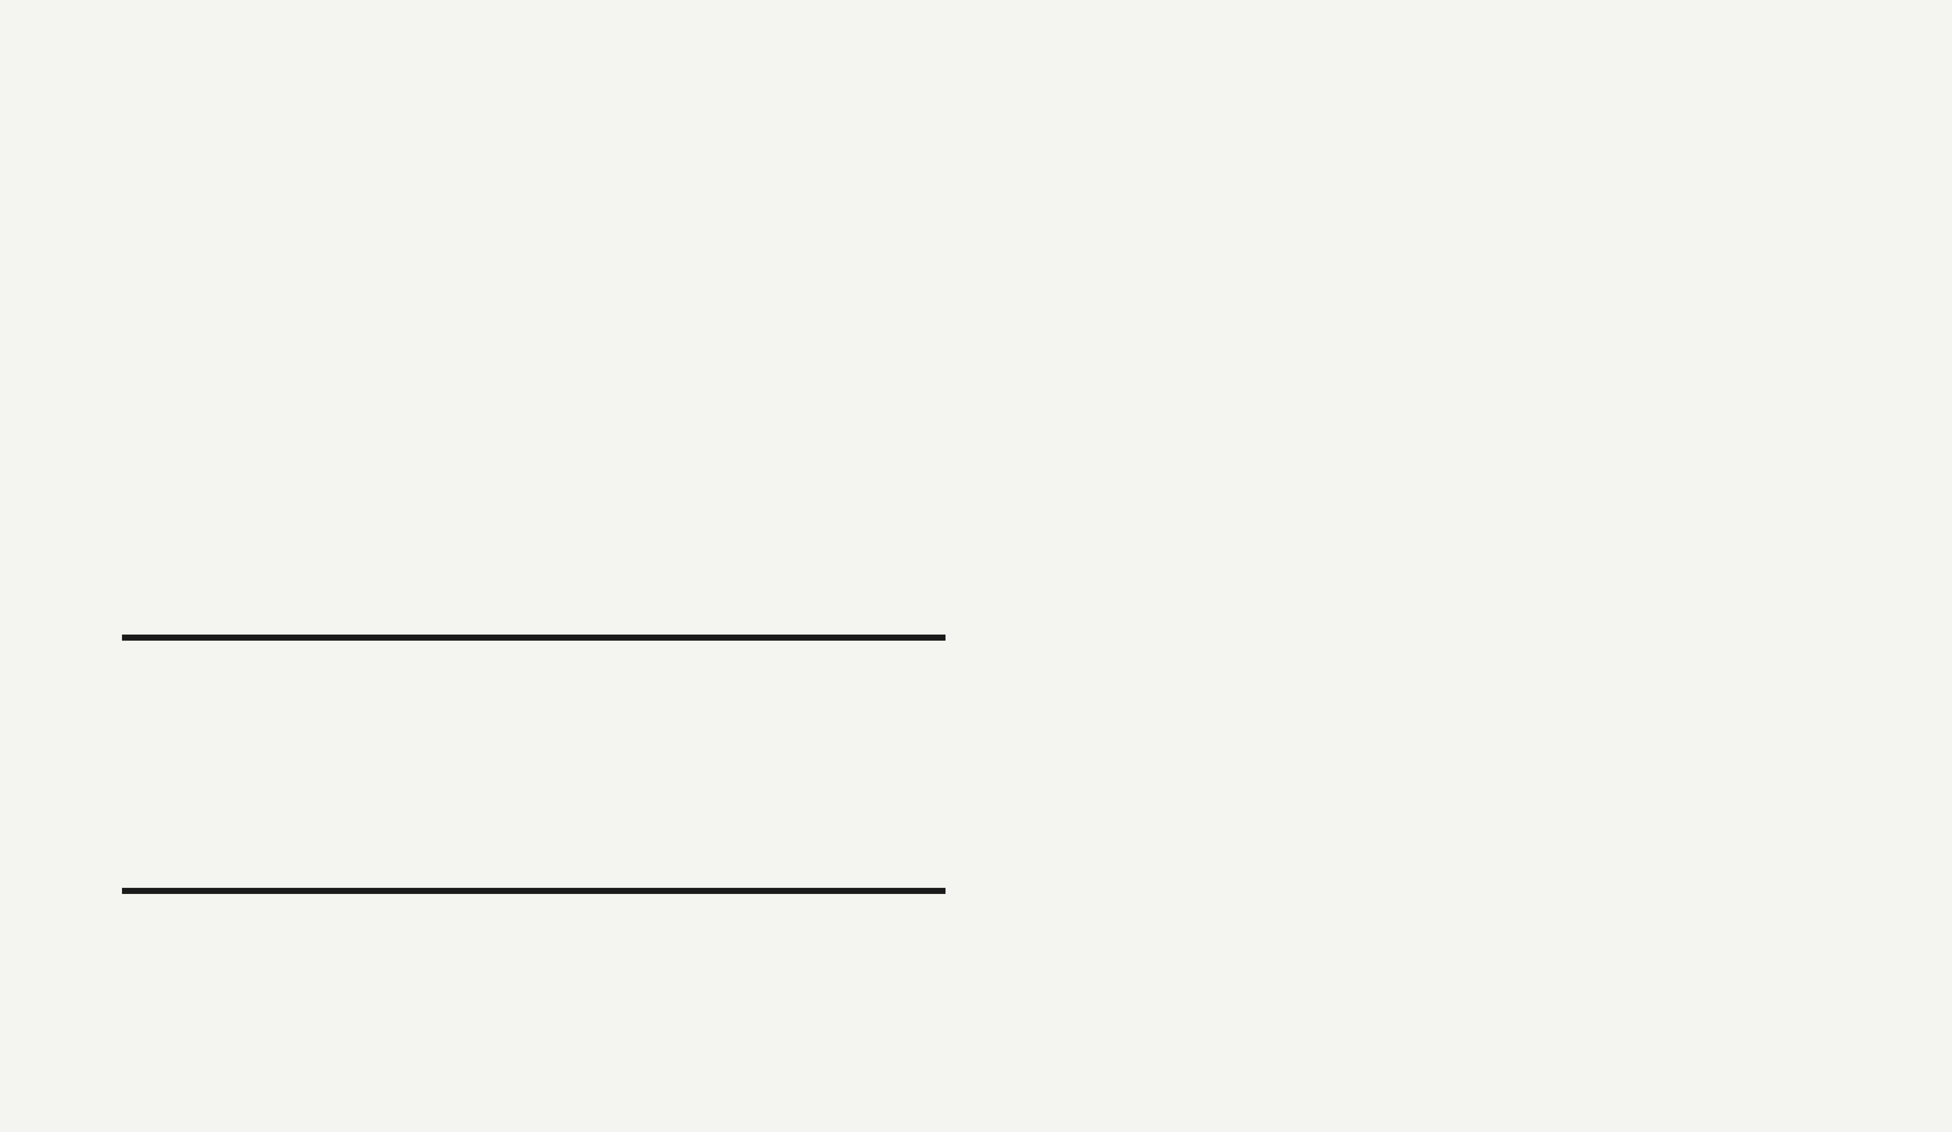
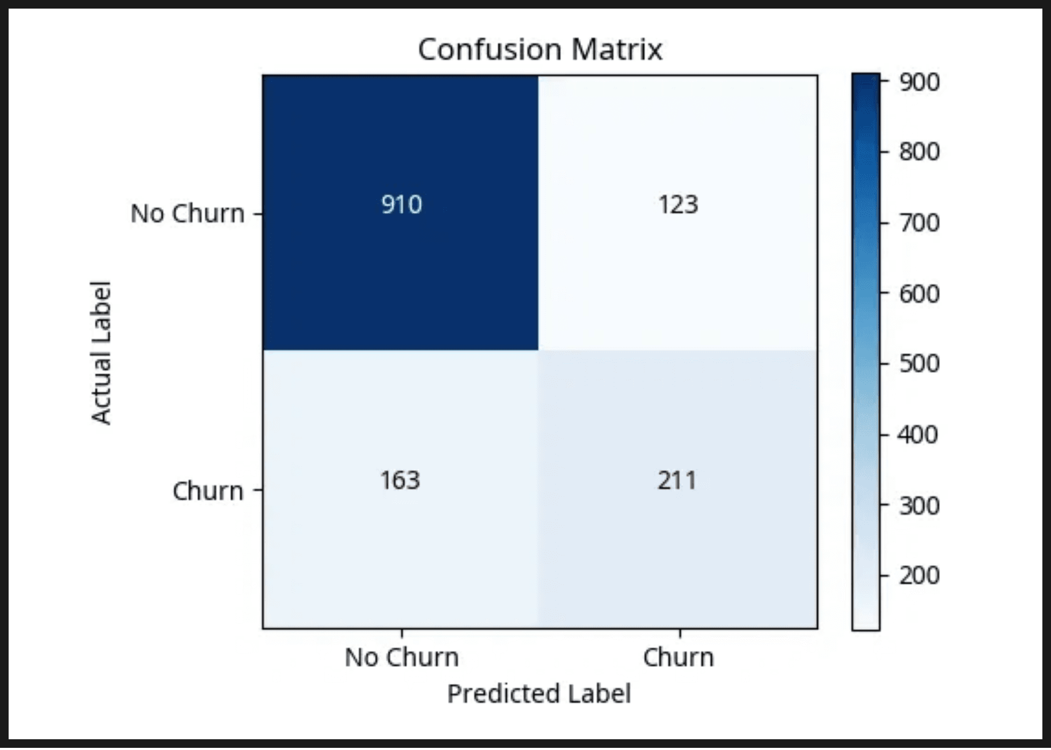
Teaching the Model
77%
Model Accuracy
Logistic Regression
We chose this model for its simplicity and interpretability. It calculates the probability of a customer belonging to the "Churn" class based on their features.
The Challenge
Confusion Matrix: Actual vs. Predicted
Class imbalance (more stayers than churners) makes accuracy a tricky metric. We use the Confusion Matrix to see exactly where the model makes mistakes.

Slide 11
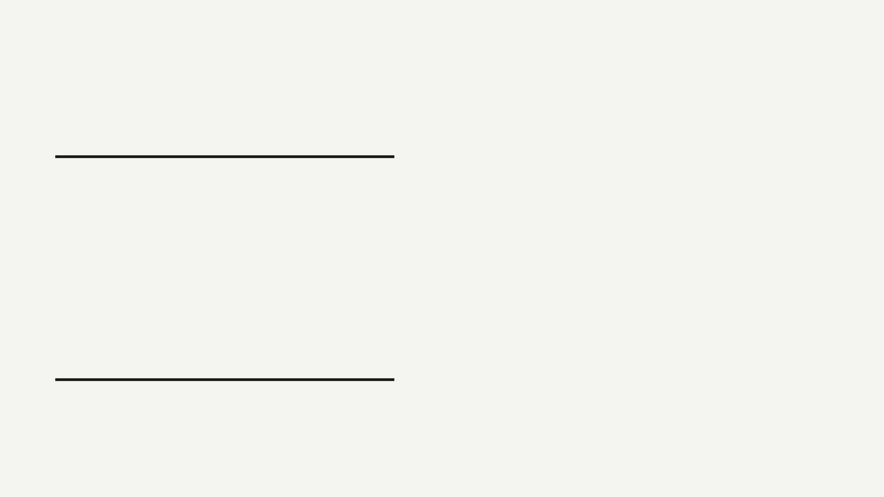
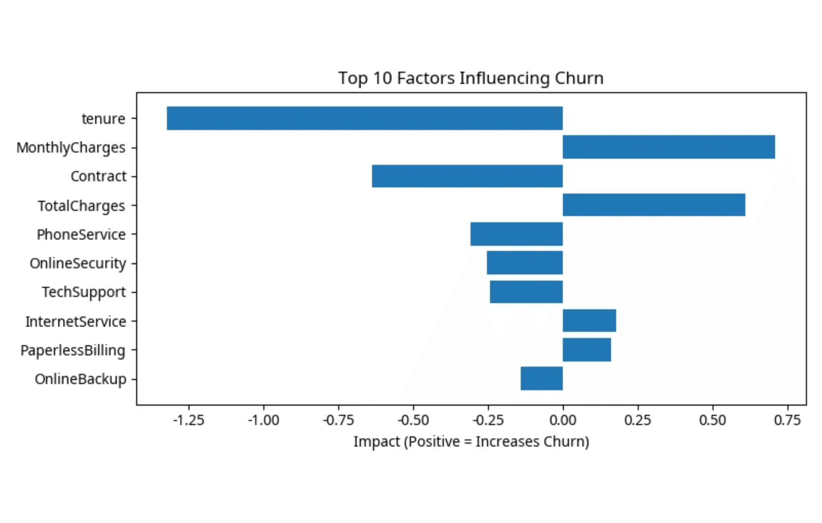
What Drives Churn?
Top Predictors
Our model identifies specific factors that either "push" customers to leave or "pull" them to stay.
Push
Monthly Charges
Push
Fiber Optic Service
Pull
Long-term Contracts
Pull
High Tenure
Teaching Point
Coefficients tell us the strength and direction of an effect. A positive coefficient means as that feature increases, churn becomes more likely.
Feature Importance: Logistic Regression Coefficients

Slide 12
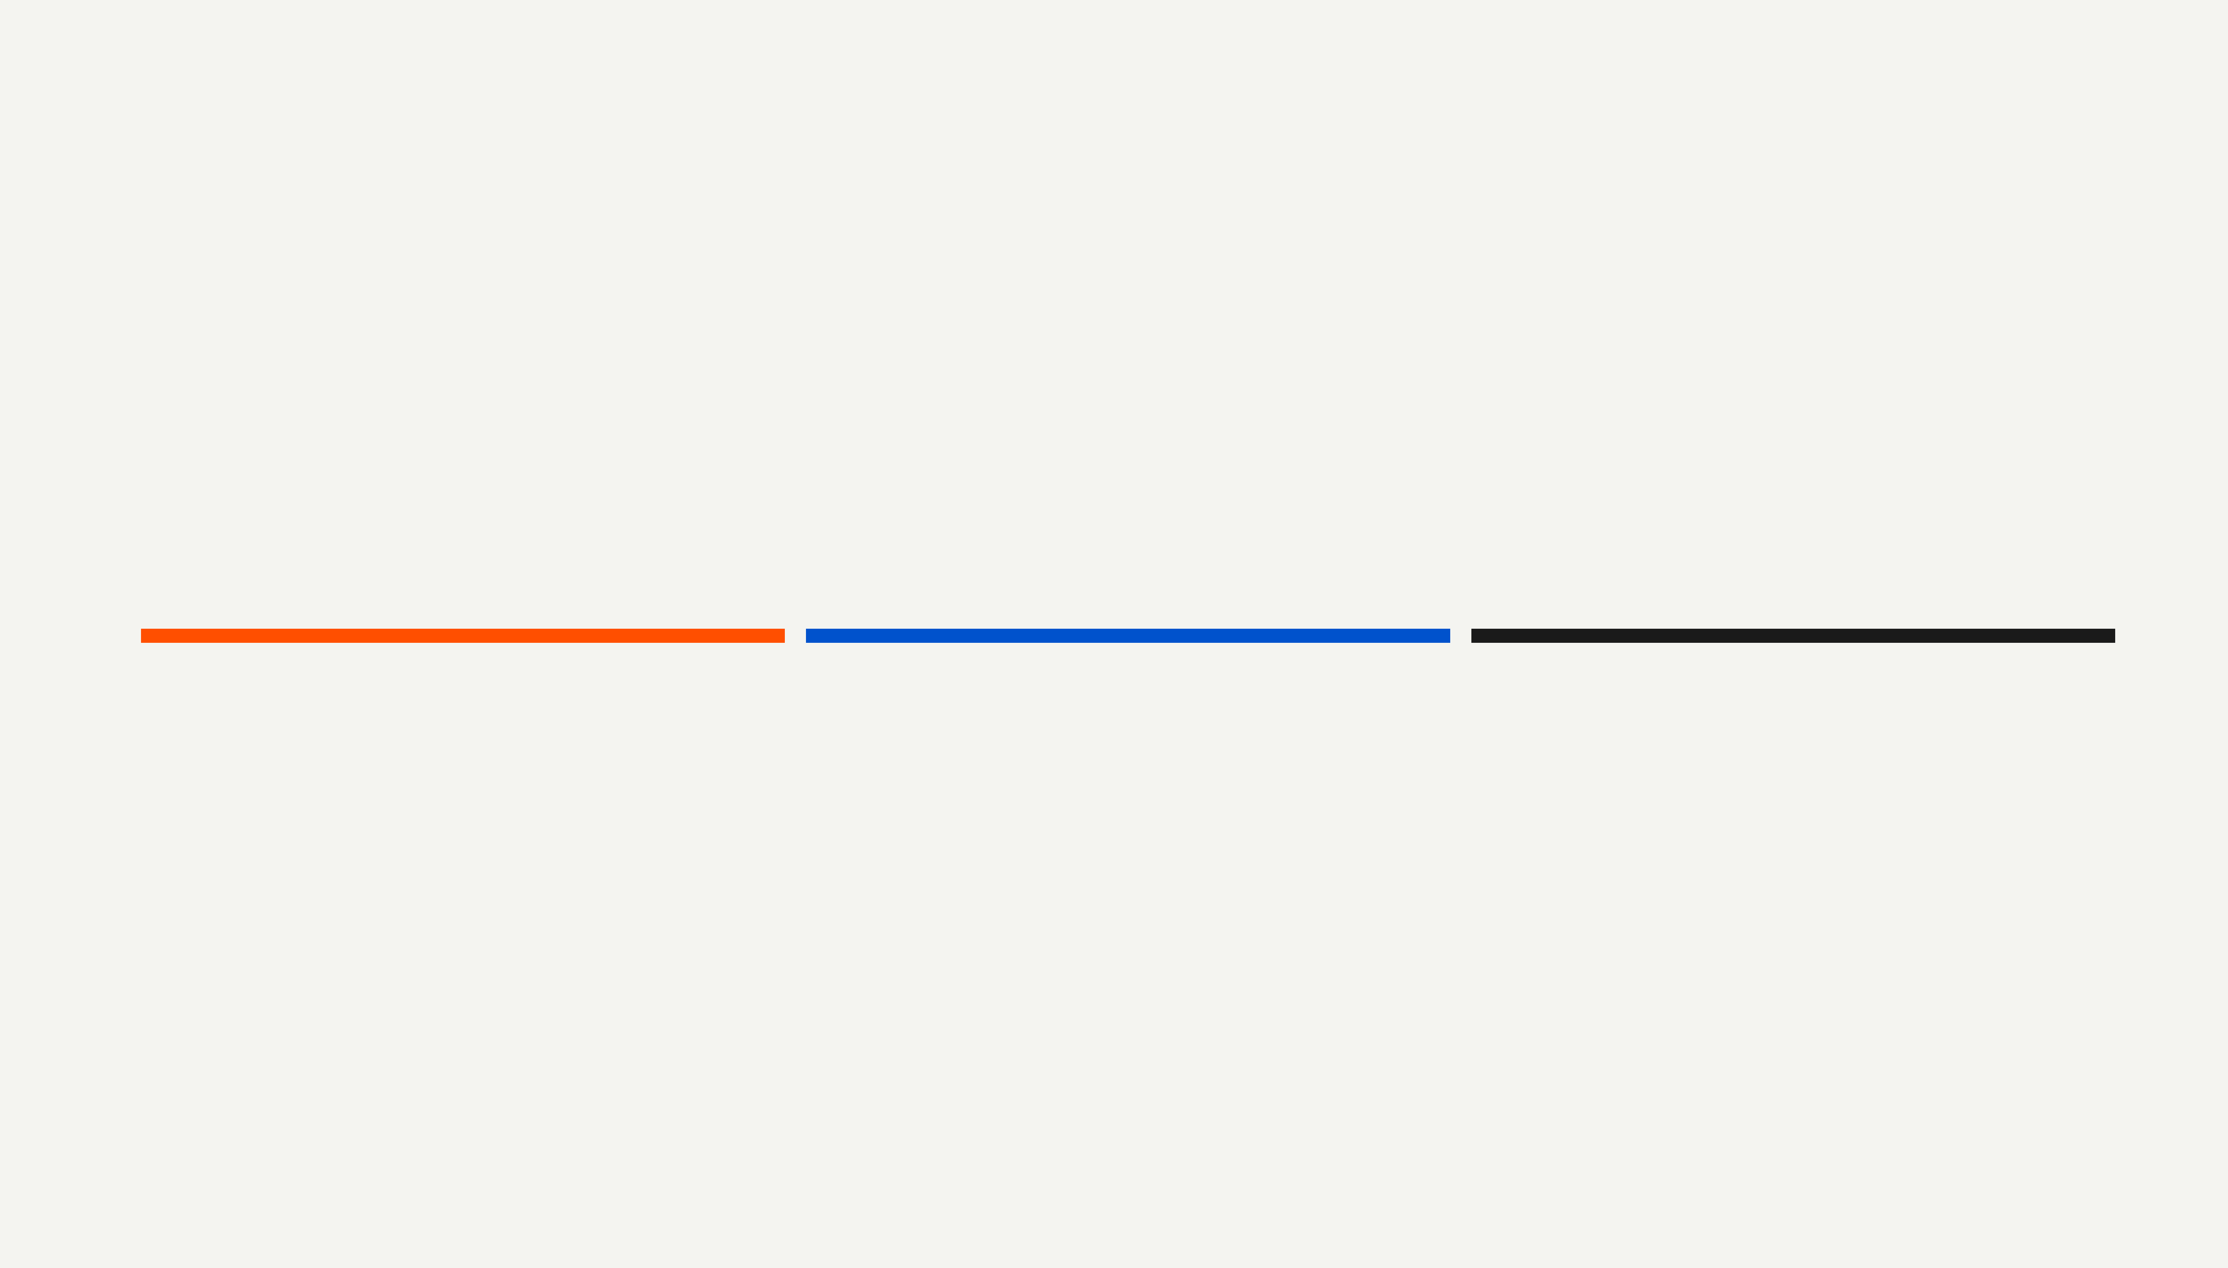
Summary & Recommendations
Our analysis identified the key drivers of customer churn, giving a data-driven foundation for strategic retention.
Focus on Newcomers
Pricing Strategy
Contract Incentives
Implement a high-touch onboarding program in the first months to reduce early churn.
Review tiers and offer targeted discounts to high-risk, high-value customers.
Incentivize month-to-month customers to switch to annual plans with focused offers.
Case Study: Customer Churn Analysis
2026 Presentation

